Slide 1
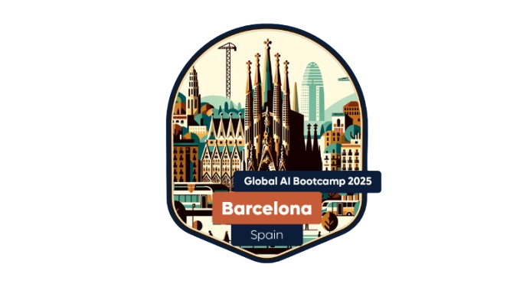

Opening Keynote

Slide 2

THANK YOU SPONSORS

Slide 3
Organizer Team

Slide 4
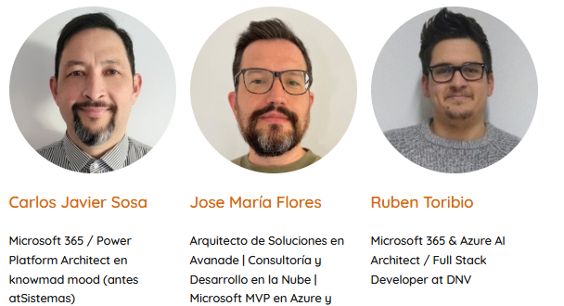
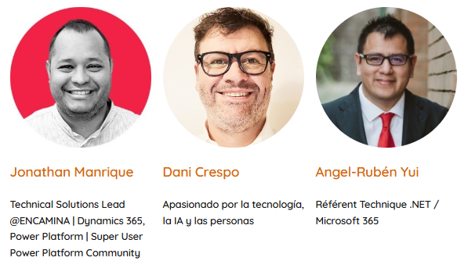
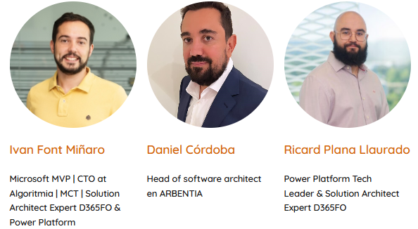
Team

Slide 5
Venue

Slide 6
Venue
Floor 6 – Sessions (Not possible to eat here)
Floor 1 - Coffee Break and Lunch
Basement – Cafeteria
If you have any intolerance, please contact staff, to list it.
Sala 1 – Algoritmia -> Open Space
Sala 2
Sala 3
Networking Area
Sponsors / Goodies Area

Slide 7
Schedule

Slide 8
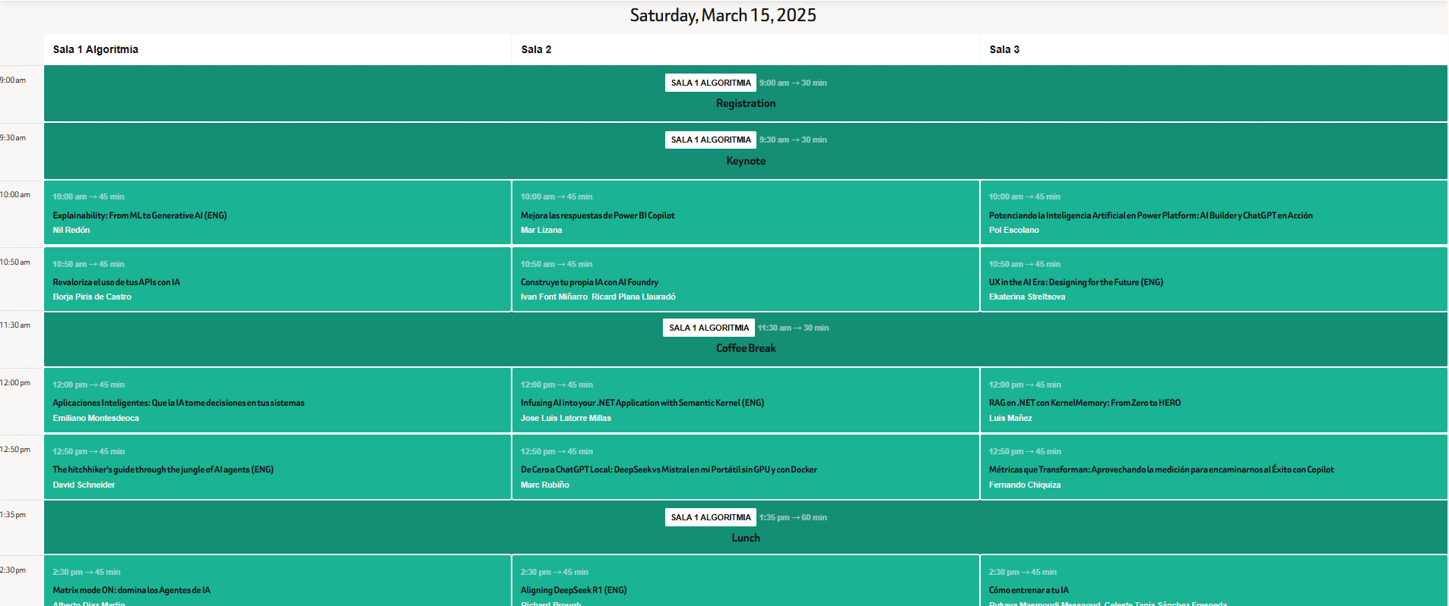
Schedule

Slide 9
Information

Slide 10
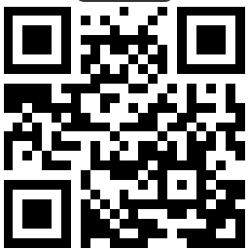
Information
Remember
Website:
https://globalaibarcelona.es/
Social Networks:
https://www.linkedin.com/in/global-ai-barcelona/
https://x.com/GlobalAIBarna

Slide 11
Raffle

Slide 12
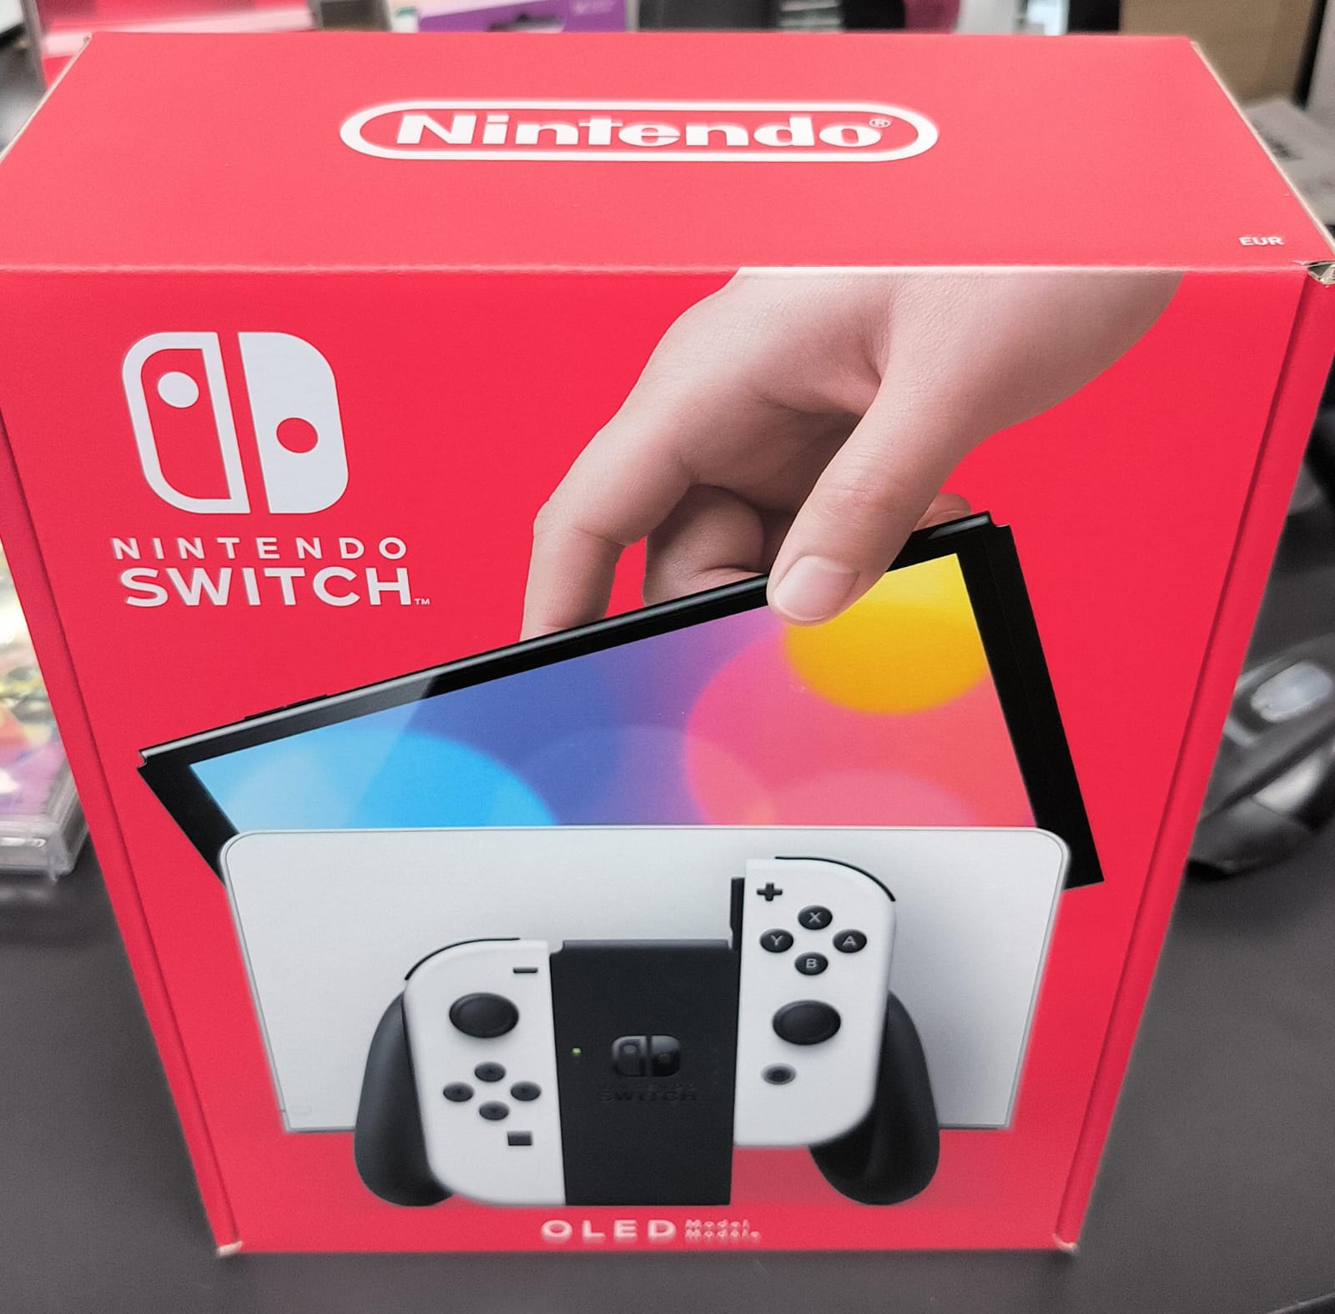
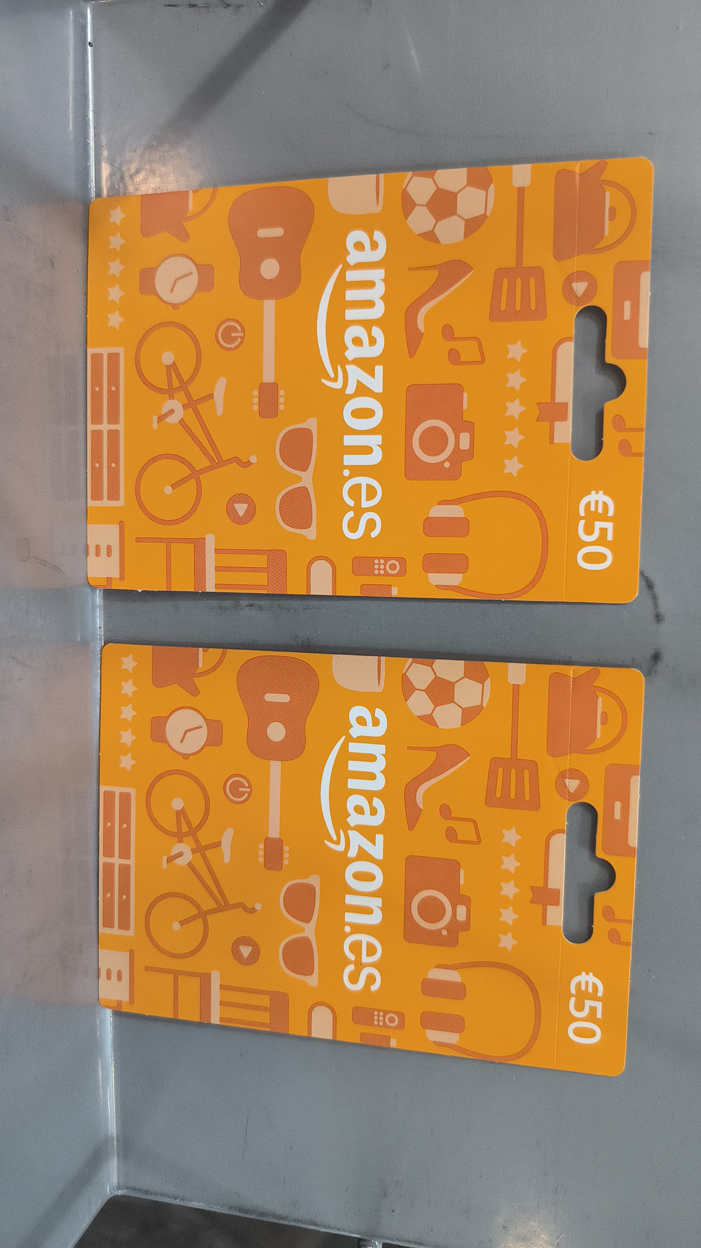
Raffle
How to enter
Be present at the event during the raffle. (Not staff, speakers)
1 Post on LinkedIn or X mentioning our account.
1 Nintendo switch
2 x 50 € Amazon gift card

Slide 13
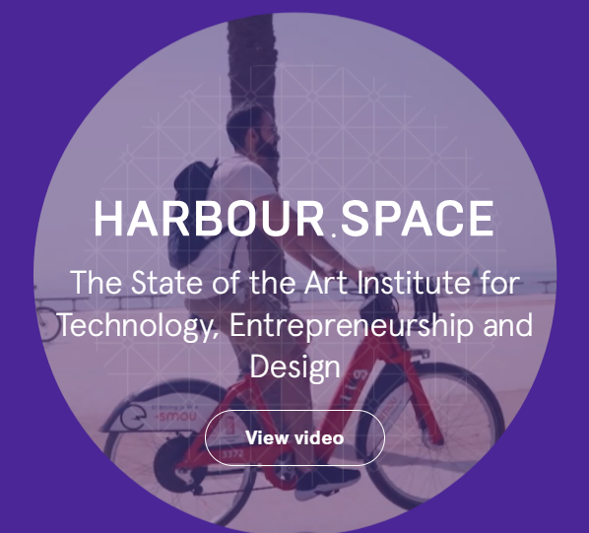
Raffle
Three-week course with Harbour.Space Institute of Technology (ENG)

Slide 14
Digital badge

Slide 15
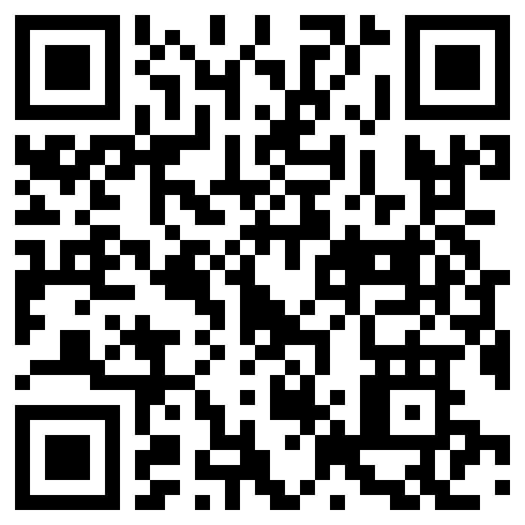
Digital badge
How to enter
Access the following QR
Create an account
Insert the code 8RJNR5
Add to your profile in Linkedin

Slide 16
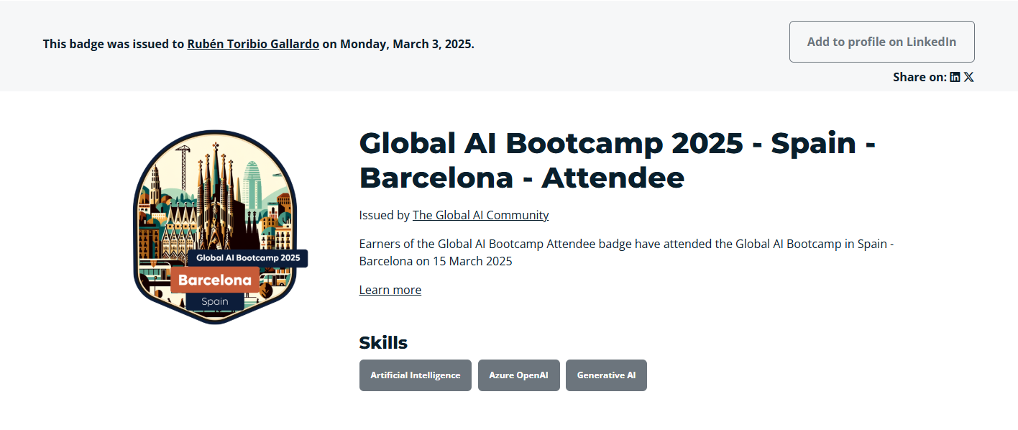
Digital badge

Slide 17
Global AI Community

Slide 18
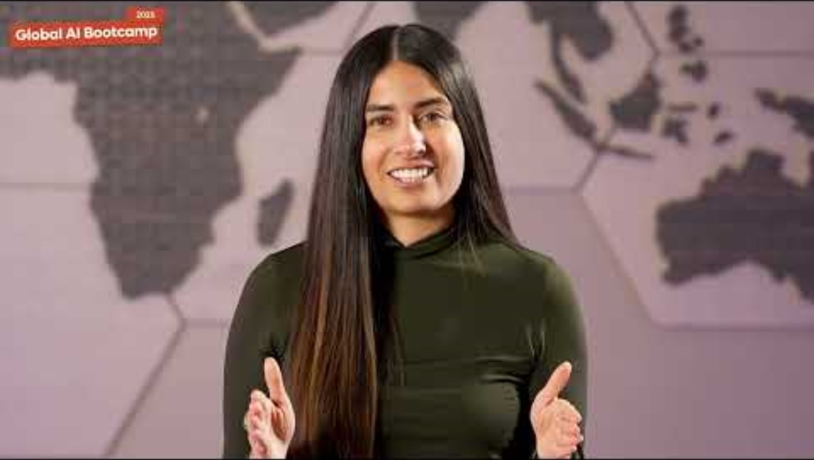
Notes:
Let’s have a look at this demo to understand what AI is capable to do today.
- Text to Speech Avatar - Live Chat Avatar
- Video Translation with Personal Neural Voice

Slide 19
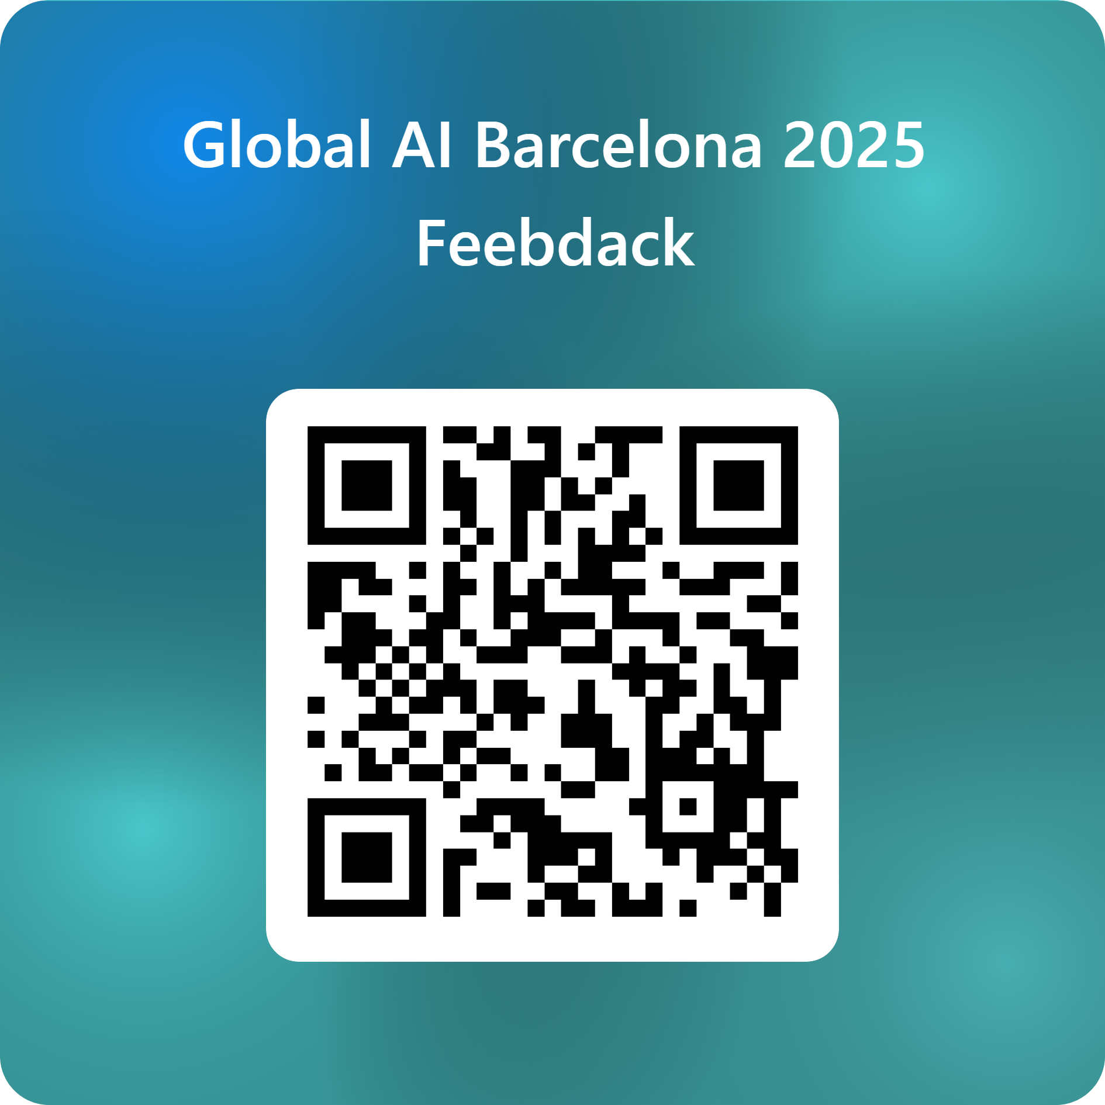
Feedback

Slide 20
THANK YOU SPONSORS

Slide 21

Questions?Thank you
Notes:
All the demos are here!

